Slide 1






VIDEO GAMES
SALES

Slide 2


02
VIDEO GAME
SALES :
POWERING A DIGITAL REVOLUTION
Video games aren’t just play—they’re profit. From console blockbusters to mobile hits, the industry generates billions each year. Digital downloads, in-game purchases, and global tournaments have turned gaming into a business empire. With every new release, the market levels up.

Slide 3


FROM ARCADES
TO APPS
Video game sales began in the late 1970s with arcade machines and home consoles like Atari. What started as coin-operated fun soon exploded into a multi-billion dollar industry. The 1990s saw iconic titles like Mario and Sonic dominate cartridge sales, while the 2000s introduced online stores and digital downloads. Today, mobile apps, cloud gaming, and in-game purchases drive massive revenue. From pixelated screens to global esports arenas, video games have evolved into one of the most powerful forces in entertainment.
03

Slide 4


PRO
GAMERS
Pro gamers are elite players who compete in video games at the highest level. They train for hours daily, mastering mechanics, strategies, and teamwork to dominate tournaments. Backed by coaches, analysts, and sponsors, they turn passion into profession — earning through prize money, salaries, streaming, and brand deals. With lightning-fast reflexes and mental endurance, pro gamers are the athletes of the digital age, inspiring millions across the globe.
05

Slide 5

Video game organizations are the driving force behind the gaming industry. They manage game development, publishing, marketing, and esports operations. Leading companies like Sony, Microsoft, Nintendo, and Tencent create iconic titles and platforms that shape global gaming trends. These organizations invest in creative studios, sponsor tournaments, and build online communities. From indie developers to billion-dollar corporations, each plays a vital role in expanding the reach and impact of video games worldwide.
VIDEO GAMES
ORGANIZATIONS
07

Slide 6



09
INDUSTRY ON
THE RISE
The global video game industry is booming — growing from ₹25 lakh crore ($298.98 billion) in 2024 to a projected ₹50 lakh crore ($600.74 billion) by 2030. With a 12.2% annual growth rate, this expansion is powered by mobile gaming, cloud platforms, and esports. Mobile alone contributes nearly 49% of total revenue, while free-to-play games dominate with 64% market share. As 5G spreads and AI enhances game development, the industry continues to break boundaries and reach new players worldwide .

Slide 7


06
PATH TO
PROFIT
Success in the video game industry is driven by innovation, engagement, and global reach. From console blockbusters to mobile sensations, each title contributes to a billion-dollar market. Developers analyze player behavior, optimize monetization strategies, and release updates to keep games fresh. Digital downloads, in-game purchases, and streaming platforms have transformed how games are sold. With every launch, the industry level
up - turning pixels into profit.

Slide 8
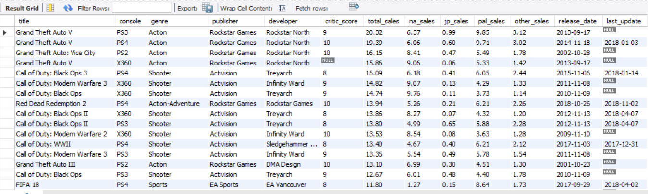
GAME DATASET OVERVIEW
THIS CURATED TABLE SHOWCASES TOP VIDEO GAMES ACROSS CONSOLES, GENRES, AND PUBLISHERS—BLENDING CRITICAL SCORES WITH REGIONAL SALES INSIGHTS. IT SERVES AS A POWERFUL FOUNDATION FOR ANALYZING MARKET TRENDS, GENRE POPULARITY, AND DEVELOPER PERFORMANCE OVER TIME.

Slide 9
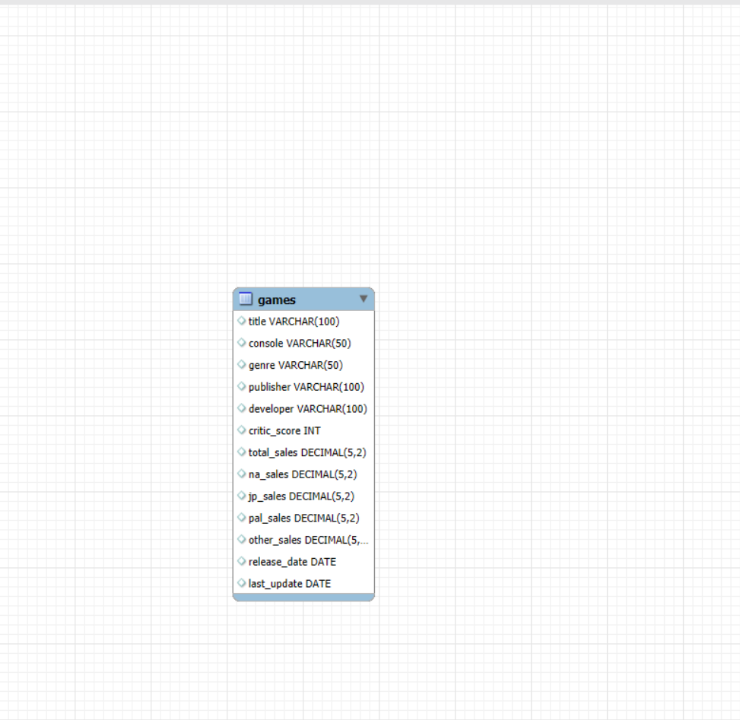
GAMES TABLE SCHEMA
THIS STRUCTURED SCHEMA DEFINES THE BACKBONE OF THE VIDEO GAME DATASET—CAPTURING TITLES, PLATFORMS, GENRES, PUBLISHERS, DEVELOPERS, CRITIC SCORES, REGIONAL SALES, AND RELEASE TIMELINES. IT ENSURES CLEAN DATA ORGANIZATION FOR EFFICIENT QUERYING, ANALYSIS, AND DASHBOARD CREATION.

Slide 10
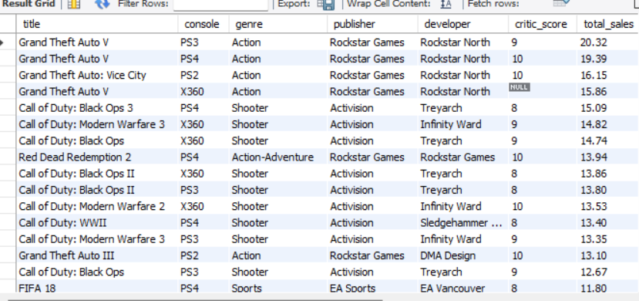

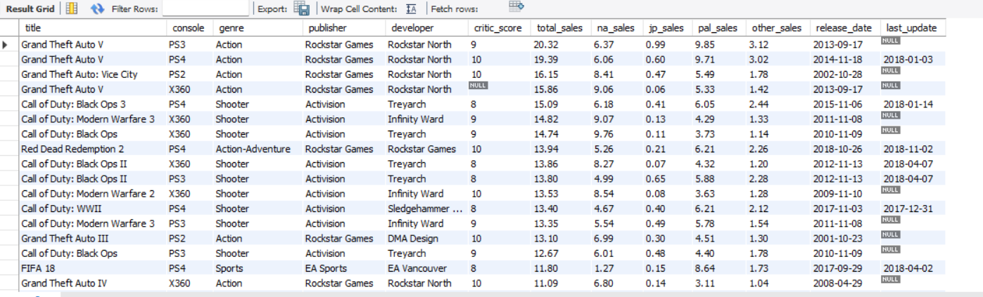
SHOW ALL GAMES❓
SELECT * FROM GAMES ;
TOTAL NUMBER OF GAMES ❓
SELECT COUNT(*) FROM GAMES;

Slide 11
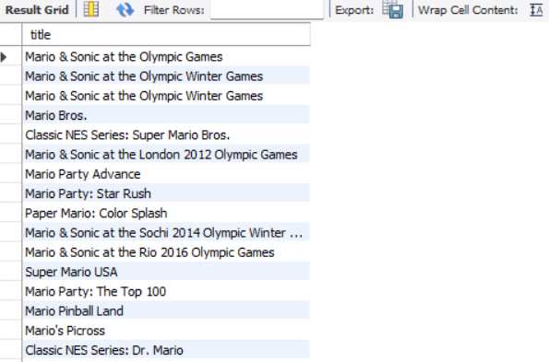
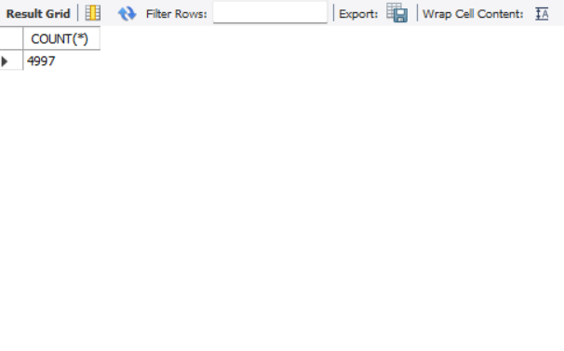
GAMES STARTING WITH "MARIO" ❓
SELECT TITLE, GENRE FROM GAMES WHERE TITLE LIKE 'MARIO%';
TOTAL COUNT * ❓
SELECT COUNT(*) FROM GAMES;

Slide 12
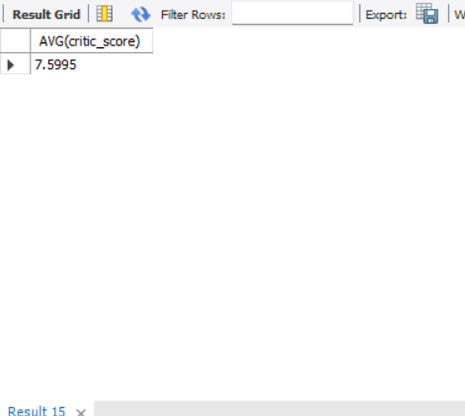
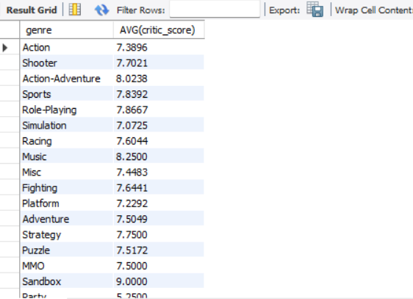
AVERAGE CRITIC SCORE ❓
SELECT AVG(CRITIC_SCORE) FROM GAMES;
AVERAGE SCORE AND SALES ❓
SELECT AVG(CRITIC_SCORE), AVG(TOTAL_SALES) FROM GAMES;

Slide 13
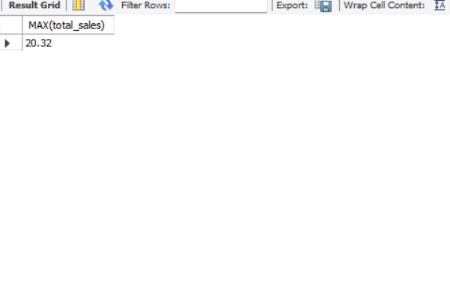
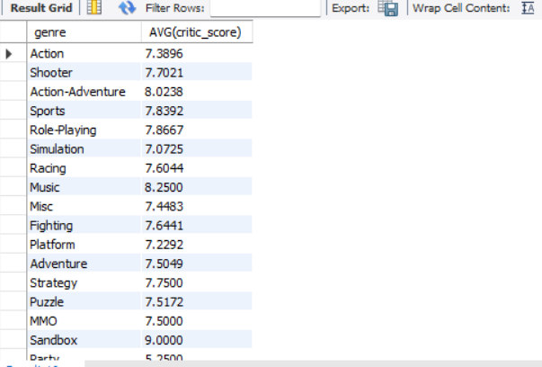
SHOW MAX *❓
SELECT MAX(TOTAL_SALES) FROM GAMES;
AVERAGE SCORE BY GENRE ❓
SELECT GENRE, AVG(CRITIC_SCORE) FROM GAMES GROUP BY GENRE;

Slide 14
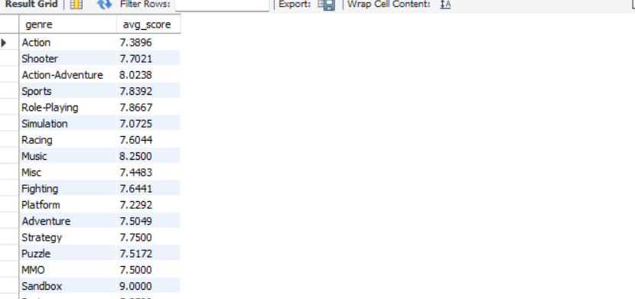
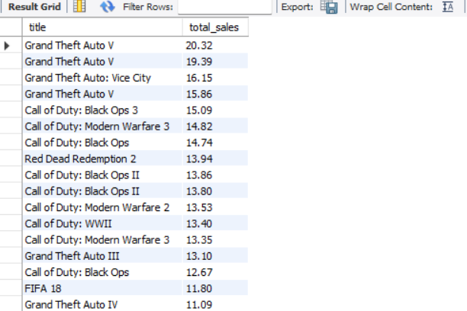
GENRES WITH SCORE > 80 ❓
SELECT GENRE, AVG(CRITIC_SCORE) FROM GAMES GROUP BY GENRE HAVING AVG(CRITIC_SCORE) > 80;
TOTAL SALES FROM GAMES❓
SELECT TITLE, TOTAL_SALES FROM GAMES WHERE TOTAL_SALES > (SELECT AVG(TOTAL_SALES) FROM GAMES);

Slide 15
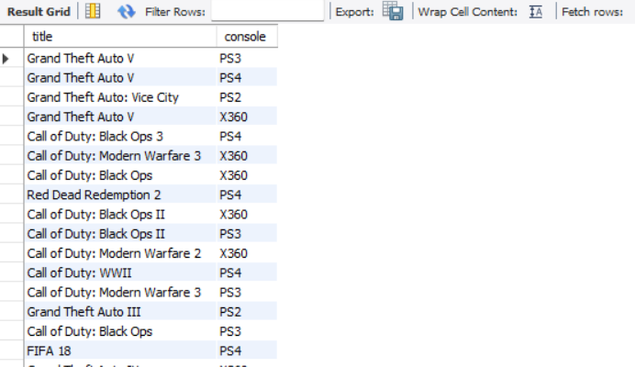
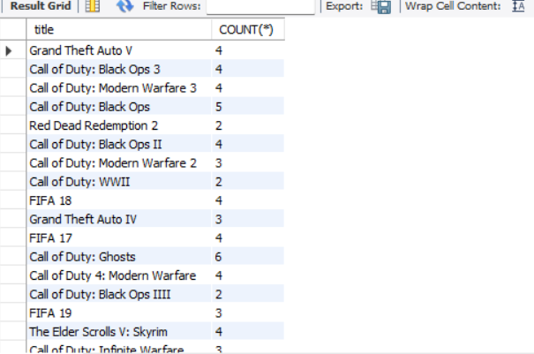
SHOW ALL CONSOLES ❓
SELECT TITLE, CONSOLE FROM GAMES;
DUPLICATE TITLES ❓
SELECT TITLE, COUNT(*) FROM GAMES GROUP BY TITLE HAVING COUNT(*) > 1;

Slide 16
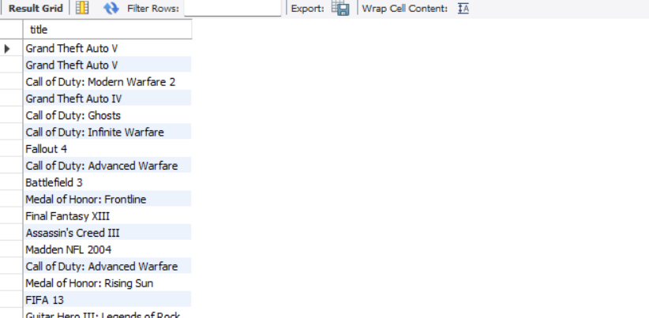
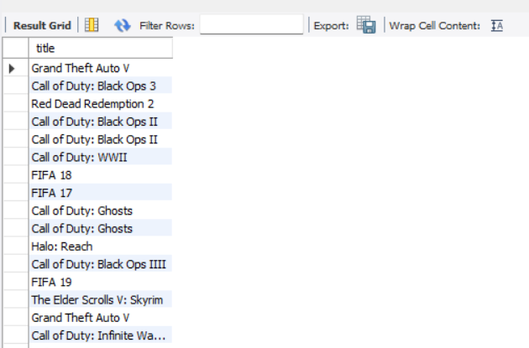
WHICH GAMES HAVE MATCHING TOTAL SALES❓
SELECT TITLE FROM GAMES WHERE (NA_SALES + JP_SALES + PAL_SALES + OTHER_SALES) > TOTAL_SALES;
WHICH GAMES ARE OUTDATED❓
SELECT TITLE FROM GAMES WHERE LAST_UPDATE <= CURDATE() - INTERVAL 30 DAY;

Slide 17
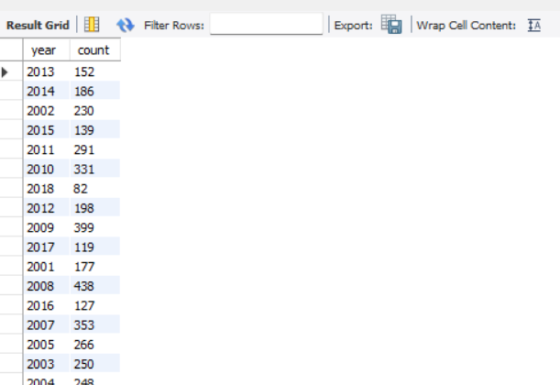
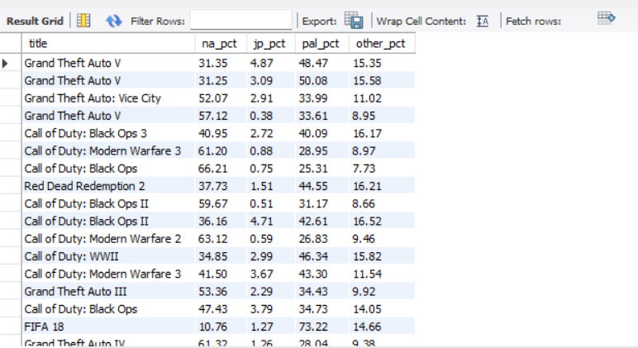
HOW MANY GAMES RELEASED PER YEAR❓
SELECT YEAR(RELEASE_DATE) AS YEAR, COUNT(*) AS COUNT FROM GAMES GROUP BY YEAR(RELEASE_DATE);
TOP GAMES BY SALES PERCENTAGE❓
SELECT TITLE, ROUND((NA_SALES / TOTAL_SALES) * 100, 2) AS NA_PCT, ROUND((JP_SALES / TOTAL_SALES) * 100, 2) AS JP_PCT,
ROUND((PAL_SALES / TOTAL_SALES) * 100, 2) AS PAL_PCT, ROUND((OTHER_SALES / TOTAL_SALES) * 100, 2) AS OTHER_PCT FROM GAMES WHERE TOTAL_SALES > 0;

Slide 18
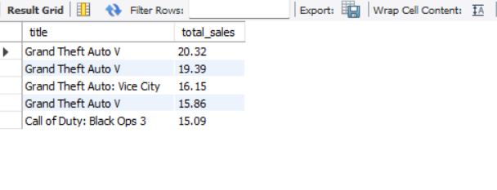
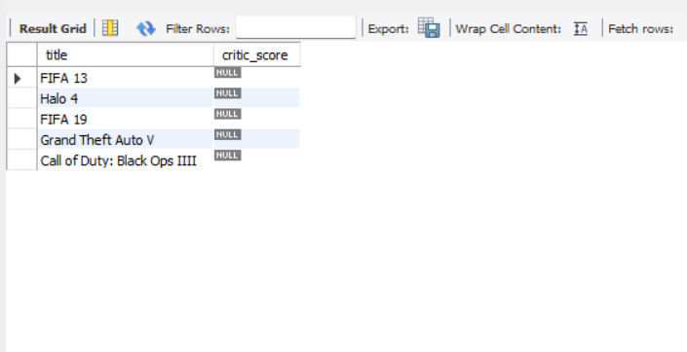
HIGHEST AVERAGE SCORED GAMES❓
SELECT TITLE, TOTAL_SALES FROM GAMES ORDER BY TOTAL_SALES DESC LIMIT 5;
WHICH GAMES HAVE CRITIC SCORES❓
SELECT TITLE, CRITIC_SCORE FROM GAMES ORDER BY CRITIC_SCORE ASC LIMIT 5;

Slide 19
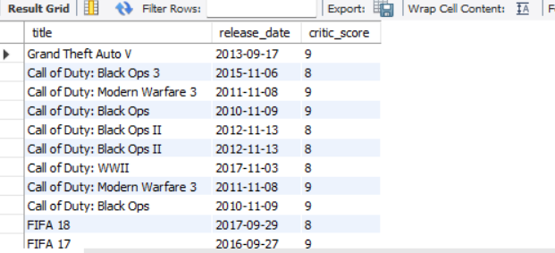
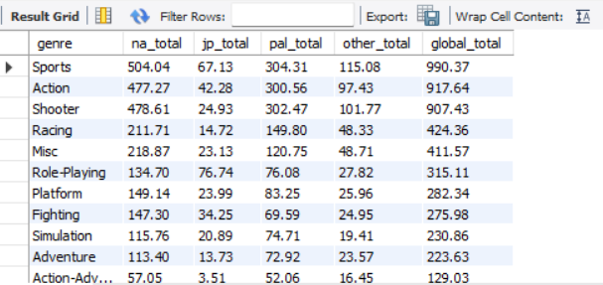
WHICH OLD GAMES RECEIVED VERY LOW CRITIC SCORES❓
SELECT TITLE, RELEASE_DATE, CRITIC_SCORE FROM GAMES WHERE RELEASE_DATE < '2020-01-01' AND CRITIC_SCORE < 10;
WHICH GENRE HAS THE HIGHEST GLOBAL SALES❓
SELECT GENRE,
ROUND(SUM(na_SALES), 2) AS NA_TOTAL,
ROUND(SUM(JP_SALES), 2) AS JP_TOTAL,
ROUND(SUM(PAL_SALES), 2) AS PAL_TOTAL,
ROUND(SUM(OTHER_SALES), 2) AS OTHER_TOTAL,
ROUND(SUM(TOTAL_SALES), 2) AS GLOBAL_TOTAL FROM GAMES GROUP BY GENRE ORDER BY GLOBAL_TOTAL DESC;

Slide 20
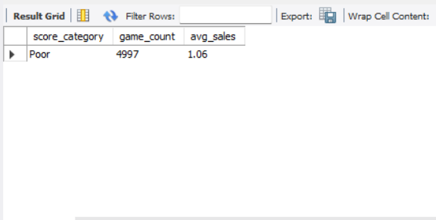
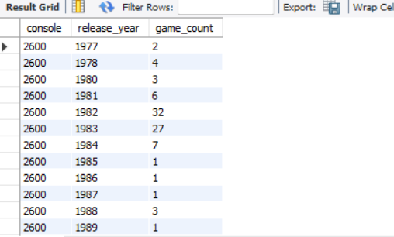
HOW DO SCORE CATEGORIES AFFECT AVERAGE SALES❓
SELECT CASE
WHEN critic_SCORE >= 90 THEN 'EXCELLENT'
WHEN CRITIC_SCORE >= 75 THEN 'GOOD'
WHEN CRITIC_SCORE >= 60 THEN 'AVERAGE'
ELSE 'POOR'
END AS SCORE_CATEGORY, COUNT(*) AS GAME_COUNT, ROUND(AVG(TOTAL_SALES), 2) AS AVG_SALES FROM GAMES GROUP BY SCORE_CATEGORY ORDER BY AVG_SALES DESC;
CONSOLE-WISE YEARLY GAME COUNT❓
SELECT CONSOLE, YEAR(RELEASE_DATE) AS RELEASE_YEAR, COUNT(*) AS GAME_COUNT FROM GAMES GROUP BY CONSOLE, YEAR(RELEASE_DATE) ORDER BY CONSOLE, RELEASE_YEAR;

Slide 21
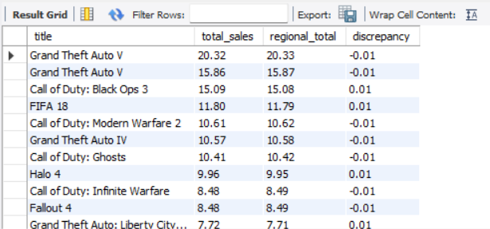
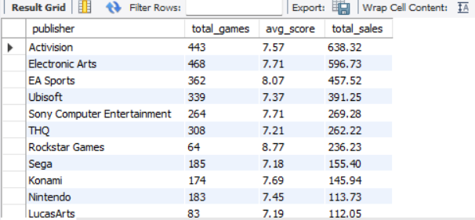
WHICH GAMES HAVE SALES DATA DISCREPANCIES❓
SELECT title, total_SALES, ROUND(NA_SALES + JP_SALES + PAL_SALES + OTHER_SALES,2 ) AS REGIONAL_TOTAL,
ROUND(TOTAL_SALES - (NA_SALES + JP_SALES + PAL_SALES + OTHER_SALES), )AS DISCREPANCY FROM GAMES
WHERE ROUND(NA_SALES + JP_SALES + PAL_SALES + OTHER_SALES, 2) != ROUND(TOTAL_SALES, 2);
TOP PUBLISHERS BY SALES AND SCORE❓
SELECT PUBLISHER, COUNT(*) AS TOTAL_GAMES,
ROUND(AVG(CRITIC_SCORE), 2) AS AVG_SCORE,
ROUND(SUM(TOTAL_SALES), 2) AS TOTAL_SALES FROM GAMES GROUP BY PUBLISHER HAVING COUNT(*) > 5 ORDER BY TOTAL_SALES DESC;

Slide 22
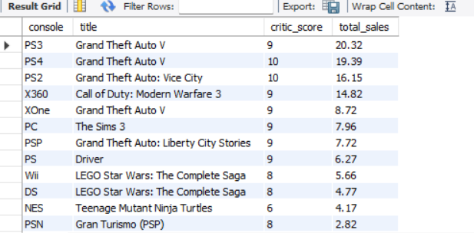
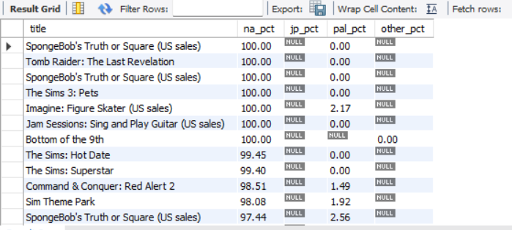
WHICH GAME HAS THE HIGHEST (CRITIC SCORE + TOTAL SALES) ON EACH CONSOLE ❓
SELECT G1.CONSOLE, G1.TITLE, G1.CRITIC_SCORE, G1.TOTAL_SALES
FROM GAMES G1 WHERE (CRITIC_SCORE + TOTAL_SALES) = ( SELECT MAX(CRITIC_SCORE + TOTAL_SALES) FROM GAMES G2 WHERE G1.CONSOLE = G2.CONSOLE);
"WHICH GAMES HAD THE HIGHEST PERCENTAGE OF SALES IN NORTH AMERICA❓
SELECT TITLE, ROUND((NA_SALES / TOTAL_SALES) * 100, 2) AS NA_PCT, ROUND((JP_SALES / TOTAL_SALES) * 100, 2) AS JP_PCT, ROUND((PAL_SALES / TOTAL_SALES) * 100, 2) AS PAL_PCT,
ROUND((OTHER_SALES / TOTAL_SALES) * 100, 2) AS OTHER_PCT FROM GAMES WHERE TOTAL_SALES > 0 ORDER BY NA_PCT DESC;

Slide 23
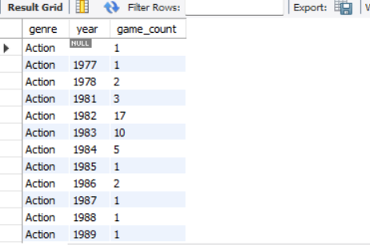
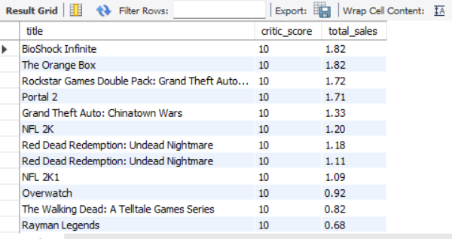
HOW MANY GAMES WERE RELEASED PER GENRE EACH YEAR❓
SELECT GENRE, YEAR(RELEASE_DATE) AS YEAR, COUNT(*) AS GAME_COUNT FROM GAMES GROUP BY GENRE, YEAR(RELEASE_DATE) ORDER BY GENRE, YEAR;
WHICH GAMES HAD CRITIC SCORES ≤ 90 AND SOLD LESS THAN 2 MILLION UNITS❓
SELECT TITLE, CRITIC_SCORE, TOTAL_SALES FROM GAMES WHERE CRITIC_SCORE <= 90 AND TOTAL_SALES < 2.00 ORDER BY CRITIC_SCORE DESC;

Slide 24
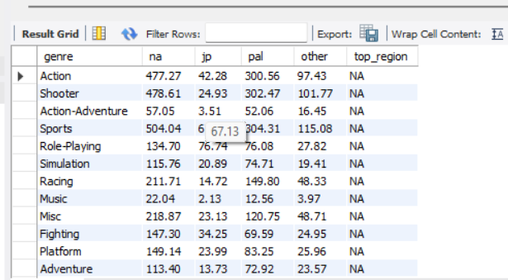
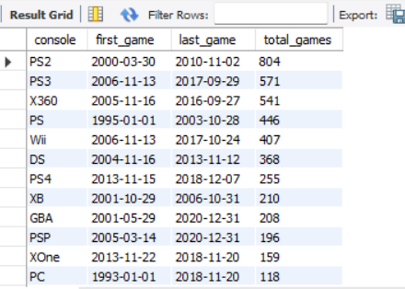
WHICH REGION HAD THE HIGHEST SALES FOR EACH GAME GENRE❓
SELECT GENRE, SUM(NA_SALES) AS NA, SUM(JP_SALES) SUM(PAL_SALES) AS PAL, SUM(OTHER_SALES) AS OTHER, CASE
WHEN SUM(NA_SALES) > SUM(JP_SALES) AND SUM(NA_SALES) > SUM(PAL_SALES) THEN 'NA'
WHEN SUM(JP_SALES) > SUM(PAL_SALES) THEN 'JP' ELSE 'PAL/OTHER END AS TOP_REGION FROM GAMES GROUP BY GENRE;
WHAT IS THE GAME RELEASE TIMELINE AND TOTAL COUNT FOR EACH CONSOLE❓
SELECT CONSOLE,
MIN(RELEASE_DATE) AS FIRST_GAME,
MAX(RELEASE_DATE) AS LAST_GAME,
COUNT(*) AS TOTAL_GAMES
FROM GAMES
GROUP BY CONSOLE
ORDER BY TOTAL_GAMES DESC;

Slide 25
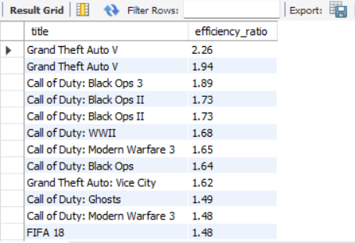
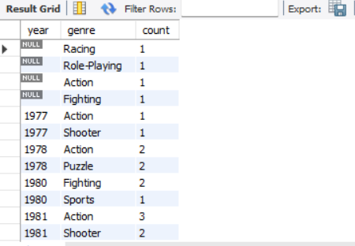
WHICH GAMES HAD THE HIGHEST SALES PER CRITIC SCORE POINT❓
SELECT TITLE, ROUND(TOTAL_SALES / NULLIF(CRITIC_SCORE, 0), 2) AS EFFICIENCY_RATIO FROM GAMES WHERE CRITIC_SCORE IS NOT NULL ORDER BY EFFICIENCY_RATIO DESC;
HOW MANY GAMES WERE RELEASED PER GENRE EACH YEAR, AND WHICH GENRES DOMINATED ANNUALLY❓
SELECT YEAR(RELEASE_DATE) AS YEAR, GENRE, COUNT(*) AS COUNT FROM GAMES GROUP BY YEAR(RELEASE_DATE), GENRE ORDER BY YEAR, COUNT DESC;

Slide 26
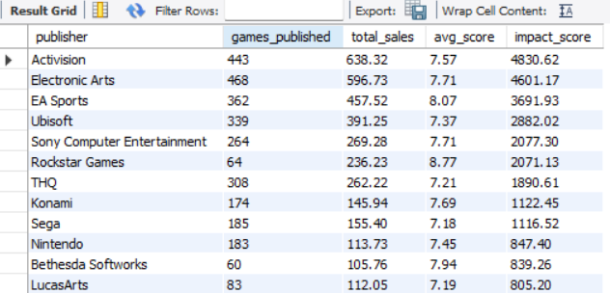
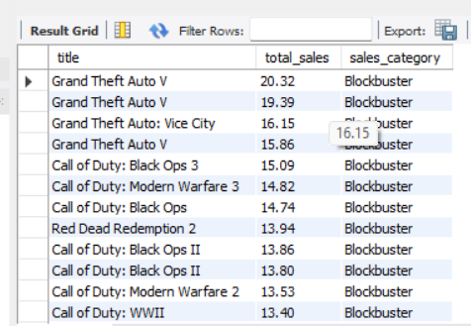
WHICH PUBLISHERS HAD THE HIGHEST IMPACT BASED ON SALES AND CRITIC SCORES❓
SELECT PUBLISHER,
COUNT(*) AS GAMES_PUBLISHED,
ROUND(SUM(TOTAL_SALES), 2) AS TOTAL_SALES,
ROUND(AVG(CRITIC_SCORE), 2) AS AVG_SCORE,
ROUND(SUM(TOTAL_SALES) * AVG(CRITIC_SCORE), 2) AS IMPACT_SCORE FROM GAMES GROUP BY PUBLISHER
ORDER BY IMPACT_SCORE DESC;
HOW ARE GAMES CATEGORIZED BASED ON TOTAL SALES❓
SELECT TITLE, TOTAL_SALES, CASE
WHEN TOTAL_SALES > 10 THEN 'BLOCKBUSTER'
WHEN TOTAL_SALES BETWEEN 5 AND 10 THEN 'HIT'
WHEN TOTAL_SALES BETWEEN 1 AND 5 THEN 'MODERATE'
ELSE 'LOW' END AS SALES_CATEGORY FROM GAMES
ORDER BY TOTAL_SALES DESC;

Slide 27
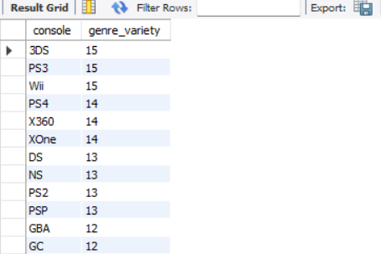
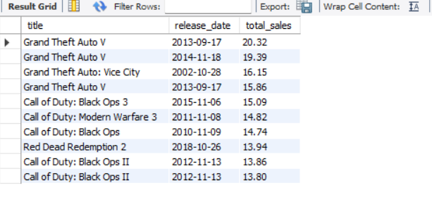
WHICH CONSOLES OFFER THE WIDEST VARIETY OF GAME GENRES❓
SELECT
conSOLE,
COUNT(DISTINCT GENRE) AS GENRE_VARIETY
FROM GAMES
GROUP BY CONSOLE
ORDER BY GENRE_VARIETY DESC;
WHICH OLDER GAMES (RELEASED OVER 2 YEARS AGO) HAVE THE HIGHEST TOTAL SALES❓
SELECT title, rELEASE_DATE, TOTAL_SALES FROM GAMES
WHERE RELEASE_DATE <= CURDATE() - INTERVAL 2 YEAR
ORDER BY TOTAL_SALES DESC LIMIT 10;

Slide 28
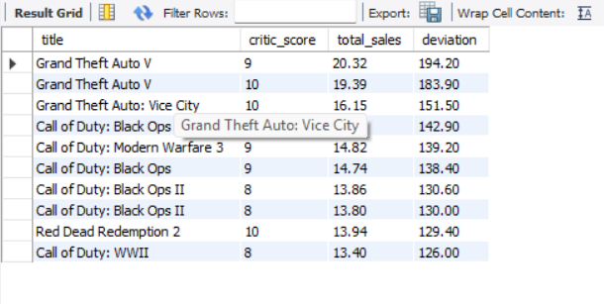
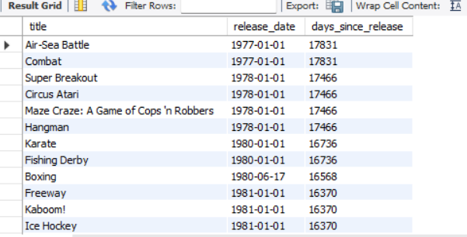
WHICH GAMES SHOW THE BIGGEST GAP BETWEEN CRITIC SCORE AND SCALED SALES❓
SELECT title, critic_SCORE, TOTAL_SALES,
ABS(CRITIC_SCORE - (TOTAL_SALES * 10)) AS DEVIATION FROM GAMES
WHERE CRITIC_SCORE IS NOT NULL AND TOTAL_SALES IS NOT NULL
ORDER BY DEVIATION DESC LIMIT 10;
WHICH GAMES WERE RELEASED THE LONGEST TIME AGO❓
SELECT title, rELEASE_DATE,
DATEDIFF(CURDATE(), RELEASE_DATE) AS DAYS_SINCE_RELEASE FROM GAMES WHERE RELEASE_DATE IS NOT NULL
ORDER BY DAYS_SINCE_RELEASE DESC;

Slide 29

THANK
YOU!
Thank you for your attention.

